Slide 1

DEPARTMENT OF COMPUTER SCIENCE & ENGINEERING (AI&ML)
LAKIREDDY BALI REDDY COLLEGE OF ENGINEERING
(AUTONOMOUS)
L.B.Reddy Nagar :: Mylavaram – 521 230 :: NTR Dist.:: A.P.
________________________________________________________________________________________________________________
Hallucination Detection and Correction in Large Language Models
Project review Batch No:13
Presented By:
Shaik Mohammad Wafeeq Ali : 23761A4253
Padakandla Ganesh : 23765A4240
Mulukuri Sreeram : 23761A4236
Nalajala Vishnu Priya : 23761A4237
Under Guidance of :
Mr I. Mallikharjuna Rao
Assistant Professor

Slide 2
Abstract
This is a proposed system designed to detect and correct hallucinations in large language models — the tendency of these models to produce confident-sounding but factually wrong or unsupported answers. This is a critical problem in fields like healthcare, law, and finance, where such errors can seriously affect trust and decision-making. The project aims to build a framework that not only flags hallucinated content in real time but also explains why it was flagged and corrects it using verified information, all without hurting the fluency of the model's output. The end goal is a system that makes LLMs more reliable, transparent, and safe to use in real-world, high-stakes applications.

Slide 3
Problem Statement
Large Language Models such as GPT, LLaMA, and Gemini frequently generate fluent but factually incorrect text — called hallucination. This occurs when output contains false, misleading, or unverifiable information not grounded in training data or context.
Key Challenges:
Serious risks in healthcare, legal, and education domains
Current LLMs lack reliable detection mechanisms
Urgent need for systematic identification and correction

Slide 4
Objective
Study and categorize hallucination types produced by LLMs (intrinsic vs. extrinsic)
Survey and evaluate existing hallucination detection techniques and their limitations
Propose an automated detection methodology combining fact-checking, RAG, and confidence scoring
Design a correction mechanism to replace or flag hallucinated content with verified information
To enhance transparency and explainability in AI outputs

Slide 5
Existing System
Retrieval-Augmented Generation (RAG)
Reinforcement Learning with Human Feedback (RLHF)
Fact-Checking Systems
SelfCheckGPT
NLI-Based Verification Systems
Knowledge Graph-Based Systems
Limitations:
High computational cost
Dependency on external databases
Real-time verification challenges

Slide 6
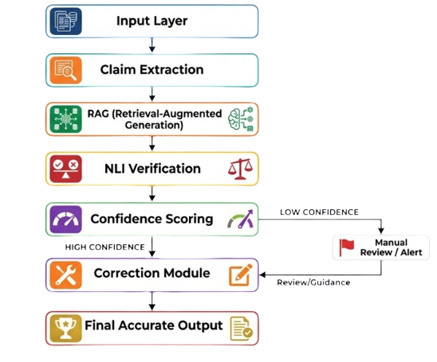
Proposed Methodology
Accept user queries and extract important factual claims from the generated response.
Retrieve verified information using Retrieval-Augmented Generation (RAG).
Validate claims using Natural Language Inference (NLI) and confidence scoring techniques.
Detect hallucinated or incorrect information and correct it using trusted evidence.
Generate accurate, reliable, and trustworthy final responses with reduced hallucinations.

Slide 7
Tools & Technologies Used
Technologies:
Python – Main programming language for AI and NLP development
Transformers & LangChain – Used for LLM integration, RAG pipeline, and text processing
PyTorch / TensorFlow – Deep learning frameworks for model training and inference
MongoDB – Database used for storing retrieved and processed information
OpenAI API & Hugging Face – Used for accessing pretrained Large Language Models and NLP tools
Datasets – TruthfulQA(Used to evaluate whether LLMs generate truthful answers)

Slide 8
Expected outcome & Workplan
Reduce hallucinations in LLM-generated responses
Improve factual accuracy and reliability of AI outputs
Detect misleading or contradictory information effectively
Generate trustworthy and corrected responses using verified data
Enhance user trust and safe usage of AI systems
Phase | Work
Phase 1 | Literature Survey and Problem Analysis
Phase 2 | Dataset Collection and Requirement Gathering
Phase 3 | Design and Development of RAG + NLI Framework
Phase 4 | Implementation of Hallucination Detection and Correction Modules
Phase 5 | Evaluation & Testing

Slide 9
References
Huang, L. et al., A Survey on Hallucination in Large Language Models, 2023.
Farquhar, S. et al., Detecting Hallucinations in Large Language Models Using Semantic Entropy, Nature, 2024.
Su, W. et al., Unsupervised Real-Time Hallucination Detection based on the Internal States of LLMs, 2024.
Chen, Y. et al., Hallucination Detection: Robustly Discerning Reliable Answers in LLMs, 2024.
Ye, H. et al., Cognitive Mirage: A Review of Hallucinations in Large Language Models, 2023.

Slide 10
Thank Q

